Slide 1

Philosophy of Data

Slide 2
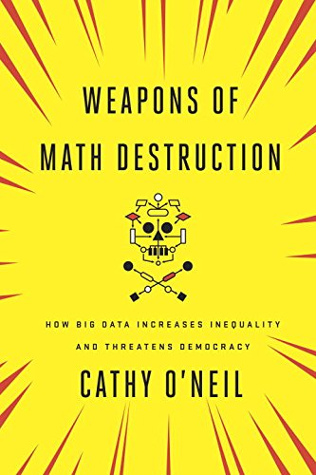
Let's remember a bit about Data 198
Discussion based class (only one exam)
Emphasis on writing and analytical thinking(½ of our WID)
Three different units
Applications – looking at specific models and how they affected those involved (WMD)

Slide 3
Unit 1
Philosophy of Science

Slide 4
Empiricism & Positivism
Empiricism is a philosophical theory that states that all genuine knowledge comes from experience.
When we talk about experience, what do we mean?
Intellectual Reasoning – Acquiring knowledge through thought, reflection, and analysis.
Sensory or perceptual Input – Gaining knowledge through the five senses (seeing, hearing, touching, tasting, and smelling).
Innate Knowledge – Possessing knowledge from birth without sensory experience.

Slide 5
Empiricism & Positivism
Empiricists believed that experimentation is the most important foundation of scientific knowledge
Positivism is a philosophical system that believes that every rationally justifiable assertion can be scientifically verified or is capable of logical or mathematical proof.
Logical Positivism was developed by members of the Vienna Circle and considers that the only meaningful philosophical problems are those which can be solved by logical analysis.

Slide 6
The Verifiability Theory of Meaning (Verificationism)
This theory comes from the statement that “The meaning of a sentence consists in its method of verification.”
It states that if you do not know how to verify a sentence, it has no meaning.
Is a crucial portion of the Logical Positivist’s school of thought.

Slide 7
Problem to Verificationism: Holism about Testing
The verifiability principle assumes that we can test sentences or theories one at a time, attaching a set of observable outcomes of tests to each sentence in isolation.
Holism suggests that one cannot test a single hypothesis in isolation. Instead, we test a complex network of claims and assumptions.
To test one claim, you must make assumptions about many other things, like instruments, circumstances of observation, reliability of records and other observers.
So, if an observations turns out to be false, we cannot assure that the hypothesis is false, as the test does not tell us where the error is.

Slide 8
External world & Inductive skepticisms
External skepticism: “We cannot know anything about the physical world that might lie behind the flow of sensations we receive.”
We are confined by a vail of our sensations, and we cannot know anything beyond that veil.
If it’s not measurable, it does not exist.
Inductive skepticism: We cannot know for sure that patterns found in the past will hold in the future.

Slide 9
External world & Inductive skepticisms
Which of the following is the definition of External and Inductive skepticism?
We cannot know for sure that patterns found in the past will hold in the future.
We cannot know anything about the physical world that might lie behind the flow of sensations we receive.
Inductive Skepticism.
External World Skepticism.
We are confined by a vail of our sensations, and we cannot know anything beyond that veil.
If it’s not measurable, it does not exist.

Slide 10
Hume’s problem of Induction
What reason do we have to believe that patterns we have found to be true in the past will repeat themselves in the future?
What justification do we have for using past observations as a basis for generalizations about things we have not yet observed?

Slide 11
The Principle of the Uniformity of Nature
1. The future always resembles the past
2. The future has resembled the past
∴ The future will resemble the past.
Hume rejected the Principle, saying we are not rationally justified

Slide 12
Hypothetico-Deductivism
”All ravens are black” → “All non-black things are non ravens”
A white shoe can confirm that all ravens are black, because it is a non-black non raven object.

Slide 13
Unit 2
Ethical Skepticism and Data Analytics

Slide 14
Ethical Skepticism and Data Analytics
What is ethics?
Who's to say what's right or wrong?
Is there such a thing as right and wrong?
What are some applications of Ethical Skepticism in Data Analytics?

Slide 15

What is ethics?
Ethics is concerned with what our guiding ideals should be, what sort of life is worth living, and how we should treat each other.
There is no rulebook to ethics, it is often complex and nuanced
Also referred to as moral philosophy
The areas of ethics/moral philosophy:
Value Theory: What makes a life go well?
Normative Ethics: What are our moral duties?
Metaethics: What is the status of ethics?
Notes:
There is no rulebook to ethics, it is often complex and nuanced

Slide 16
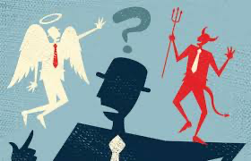
Morality
There is no widely agreed upon definition for morality
Focused on the good life, our duties to others, the nature of good and bad character traits, among other things
Moral Theory: a general principle or set of principles that tells us what is morally right (good/bad) in a wide variety of cases
Ethics attempts to evaluate different moral theories by analyzing their logical consistency

Slide 17
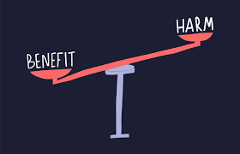
Harms & Benefits
Harm: negatively affects or diminishes some persons’ chances of having a good life or living well
Benefit: positively affects or improves some persons chances of having a good life or living well
A harm or benefit is ethically significant when it involved choice
Being struck by lightning is a harm but that is up to chance

Slide 18

Ethics & Data Analytics
Ethically significant benefits:
Human understanding
Efficiency
Predictive accuracy and personalization
Ethically significant harms:
Fairness and justice
Privacy and security
Transparency and autonomy
Notes:
Fairness and justice:
Bias is not always harmful or unjust. A bias against a convicted bank robber when reviewing job applications for a bank security guard is entirely reasonable. Biases that rest of falsehoods, sampling errors, and unjustifiable discriminatory practices are too common in data practice.
Privacy and Security:
Even anonymized datasets can reveal intimate facts about us
Very personal information about us may be stored somewhere without our knowledge or consent
We have no say over the release of that information
Ex: data identifying victims of domestic violence
Transparency and Autonomy:
transparency: ability to see how a given social system or institution works
Ex: knowing why a bank denied your application for a home loan
Autonomy: one’s ability to govern or steer the course of one’s own life
If you lack autonomy, you have no ability to control the outcome of your life

Slide 19
Case Study: Google’s Ad Algorithm
Study Overview:
Annupam Datta, a Carnegie Mellon professor, developed Ad Fisher (2015) to analyze how Google’s ad personalization affects job-seekers.
He created fake accounts that only visited job sites, with gender as the only differentiating factor.
Key Findings:
Male job seekers were significantly more likely to see high-paying executive job ads.
Male group: 1,852 times
Female group: 318 times
Google’s Response:
Machine learning reflects user behavior → If users interact in gendered ways, algorithms may reinforce biases.
Google allows advertisers to target specific demographics, but they have policies guiding ad targeting.
Addressing Bias in Algorithms:
How can we prevent bias in AI-driven ads?
Notes:
How can we prevent bias in AI-driven ads?
Increase transparency in ad delivery algorithms.
Implement fairness constraints to reduce bias.
Regular audits and monitoring of ad distribution.
Ensure diverse training data to prevent reinforcing societal biases.

Slide 20
Ethical Objectivism
Ethical Objectivism: the view that some moral standards are objectively current and that some moral claims are objectively true
What is objectivity?
Apply to everyone regardless of belief or indifference
Independent of satisfying anyone’s desires
Activity:
Is the following claim an objectively true moral claim?
“Everyone should be treated equally.”

Slide 21
Moral Skepticism
Moral Skepticism: the denial of ethical objectivism, there are no objectively true moral claims
Two forms:
Ethical Relativism: the view that there are some moral truths but that they are relative to each person or society
In some societies arranged marriages are seen as a moral duty while in others they are a violation of personal freedom.
Moral Nihilism: the view that there are no moral truths at all
There is no inherent moral difference between helping someone and harming them—any judgment about their rightness or wrongness is purely subjective.

Slide 22
Ethical Relativism
Ethical Subjectivism:
An act is morally (acceptable/wrong) just because I (approve/disapprove) of it or my commitments allow it
Cultural Relativism:
An act is morally (acceptable/unacceptable) just because it is (allowed/forbidden) by the ideals of the society in which it is performed
Implications:
Moral progress seems to be impossible
It’s impossible for one’s personal or cultural ideals to ever be mistaken
No room for questioning moral commitments
The moral views of all individuals or all cultures are equally legitimate
Opposing viewpoints generates contradictions

Slide 23
Ideal Observers
An Ideal Observer: a fully informed and perfectly rational version of oneself
Ideal Observer Subjectivism: an act is morally right just because I would favor it if I were fully informed and perfectly rational
The Priority Problem:
If there are good reasons to back the verdicts of ideal observers, then these reasons are what make acts right or wrong

Slide 24
Moral Nihilism
Moral Nihilism: the view that there are no moral truths
Two Types: Error Theory & Expressivism
Error Theory:
There are no moral features in this world
No moral judgements are true
Our sincere moral judgements try, and always fail to describe the moral feature of things
Expressivism:
There are no moral features in this world
No moral judgements are true
Our sincere moral are not attempts to describe the moral features of things but serve to vent our emotions, command others to act in certain ways, or reveal plans of action

Slide 25
Unit 3
Normative Ethics and Data Science

Slide 26
Moral Theory
Moral Theory:
A general principle, or set of principles, that tells us what is morally right in a wide variety of cases
Central claim of moral philosophy: assess the plausibility of competing moral theories by using rational argument

Slide 27
Psychological Egoism
Is the theory that all human actions aim at avoiding some personal loss or gaining some personal benefit
Surprising implication: if psychological egoism is true --> altruism doesn't exist
Altruism: the direct desire to benefit others for their own sake
Not an ethical theory
It does not tell how we ought to behave
But a descriptive theory about how we do behave
Two arguments for psychological egoism
Argument from Expected Benefit
Argument from Our Strongest Desire

Slide 28
Ethical Egoism
Evidence against psychological egoism
Empathy-altruism hypothesis: empathy can prompt altruistic motivation
Ethical egoism states:
Actions are morally right just because they best promote one's self-interest
Actions are morally wrong just because they fail to promote one's self-interest
Psychological egoism is a possible source of ethical egoism but one can be an ethical egoist without being a psychological egoist
Problems:
Violates core moral beliefs (requires extremities when they are in our self-interest)
Cannot allow for the existence of moral rights (Any harm whatsoever is justified if it is in a person's self-interest to commit it)
Arbitrarily makes one's interests all-important

Slide 29
Consequentialism
States that acts are morally right just because they maximize the amount of goodness in the world
The act that yields the greatest balance of benefits over drawbacks is the optimific action.
Act Utilitarianism: is the most prominent version of consequentialism
There is one ultimate moral standard: the principle of utility
The Principle of Utility: an action is morally required just because it does more to improve overall well-being than any other action you could have done in the circumstances

Slide 30
Well-being
Theories of well-being attempts to state what it is for life to go well --> They seek to specify what is intrinsically good for us
Instrumental vs Intrinsic value
Instrumentally valuable if it is valuable because of the goods it brings about
Intrinsically valuable if it is valuable for its own sake
Hedonism states:
Well-being = "happiness"
Happiness is a combination of pleasure and the absence of pain
Physical vs Attitudinal pleasure
Physical pleasure: pleasant feelings or sensation
Attitudinal pleasure: the positive attitude of enjoyment
Hedonists think that attitudinal pleasure is what has intrinsic value

Slide 31
Act Utilitarianism
View of consequentialism: we must do whatever creates the greatest net balance of happiness over unhappiness
Attraction of Utilitarianism:
Impartiality: everyone's interests count equally
Justifies conventional moral wisdom: crime is wrong as they make people unhappy (contrast ethical egoism)
Conflict resolution: utilitarianism gives us a method for making difficult moral decisions
Moral flexibility: explains why moral prohibitions (against lying, stealing, etc.) may sometimes be broken
The Moral Community:
Consists of those whose interests we are morally obligated to consider for their own sake
For utilitarians, the moral community consists of all beings capable of suffering

Slide 32
Kantianism
Kant's Principle of Universalizability: An action is morally acceptable if and only if its maxim is universalizable
A maxim is a principle or rule that one gives to oneself when acting – It states what and why one is going to do
A maxim is universalizable if and only if one's goal could be achieved in a world in which everyone acted on the maxim
If we acted on a maxim that cannot be universalized, we are being inconsistent or irrational
Principle of Humanity: always treat a human being (yourself included) as an end, and ever as a mere means
Good will: Kant claims that the only thing that is good in all circumstances is a good will
Moral worth: Kant claims that the only actions that possess moral worth are actions performed from a good will

Slide 33
Case Study: Value-Added Models
Value-Added Models (VAM):
Statistical model used to measure teacher effectiveness based on student test scores
O'Neil argues that the model is deeply flawed and leads to unintended negative consequences
Problems with VAMs:
Inaccuracy and statistical noise: method produce unreliable results, scores vary dramatically year to year due to external factors
Ignores external factors
High-stakes consequences: used to decide teacher firings, denying tenures, and closing schools
Perpetual inequality: O'Neil argues VAMS deepen existing inequalities

Slide 34
Case Study: Value-Added Models
Relation to Act Utilitarianism:
Harms teachers and students
Fails to improve education
Better alternatives exist
Relation to Kantian Ethics:
Fails the Universalizability test
Treats teachers as mere means, not an end (treated as numbers and statistics, not for their intrinsic worth)
Undermines fairness and moral duty

Slide 35
Case Study Example

Slide 36

PredPol
What is PredPol?
Predictive policing algorithm designed to forecast where crimes are likely to occur.
Used by multiple police departments in the U.S. to allocate resources efficiently.
How Does It Work?
Analyzes historical crime data (location, time, type of crime).
Uses machine learning to identify patterns and generate "hot spot" maps for patrols.
Primarily focuses on property crimes and some violent offenses.

Slide 37
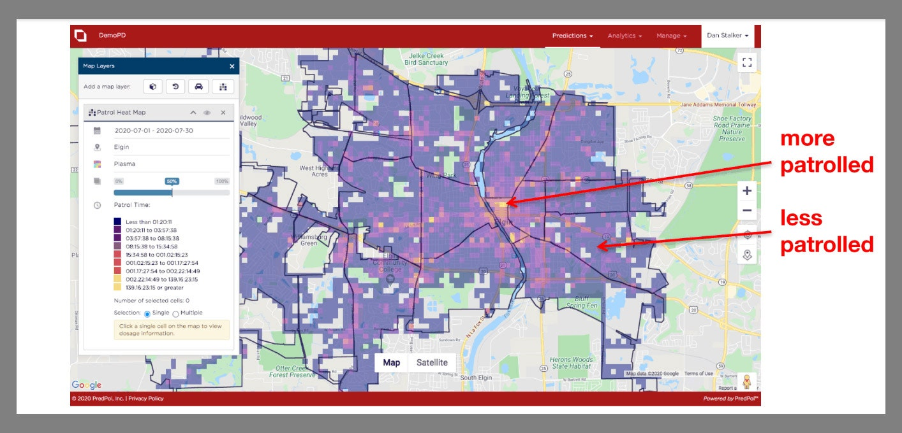
Early Success & Potential Benefits
Improved efficiency in crime prevention.
Reduced bias by relying on data instead of individual discretion.
Optimized resource allocation by focusing patrols on high-risk areas.
Initial Results:
Reported 23% decrease in burglaries in early studies.
Police could be stationed in areas where crimes were more likely.
Focused on locations rather than individuals, aiming to be racially neutral.

Slide 38

Ethical Concerns & Act Utilitarianism
Act Utilitarianism:
Ethical framework judging actions by their impact on overall happiness (pleasure vs. pain).
Unintended Consequences:
Disproportionate policing in Black and Hispanic neighborhoods.
Increased arrests for minor offenses (petty theft, drug possession, underage drinking).
Created a self-perpetuating cycle:
More policing → More crime reports → More justification for patrols.

Slide 39

The Pipeline to Prison Effect
More patrols in certain areas → More arrests → Data reinforces "high-crime" label → More policing.
Leads to increased surveillance, stress, and mistrust in these communities.
Bias in Data:
Crime reports reflect existing biases in law enforcement.
Creates feedback loops disproportionately targeting minority communities.
Lack of Transparency: Algorithm’s decision-making process is often unclear.
Over-Policing: More patrols → More minor arrests → More criminal records.
Effectiveness Questioned: Some studies suggest PredPol does not significantly reduce crime.

Slide 40
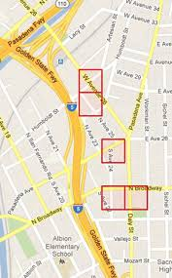
PredPol and White-Collar Crime
Why do you think predictive policing focuses on street crime but not white-collar crime? Should algorithms be used to predict corporate fraud?
Targets street-level crimes, not financial fraud, corporate crime, or cybercrime.
Ethical Concern:
High-impact crimes (e.g., fraud, insider trading) harm millions yet remain overlooked.
Raises equity issues in law enforcement: Why prioritize petty theft over billion-dollar fraud?

Slide 41
Is PredPol Morally Justifiable?
The Trade-Off:
Does reduce some crimes, but at a high ethical cost.
Disproportionately harms minority communities while ignoring major financial crimes.
Fails Act Utilitarianism:
Causes more pain than pleasure for society as a whole.
Key Takeaways:
Raises concerns about fairness, bias, and the limits of data-driven law enforcement.
Should predictive policing algorithms play a role in modern law enforcement?

Slide 42
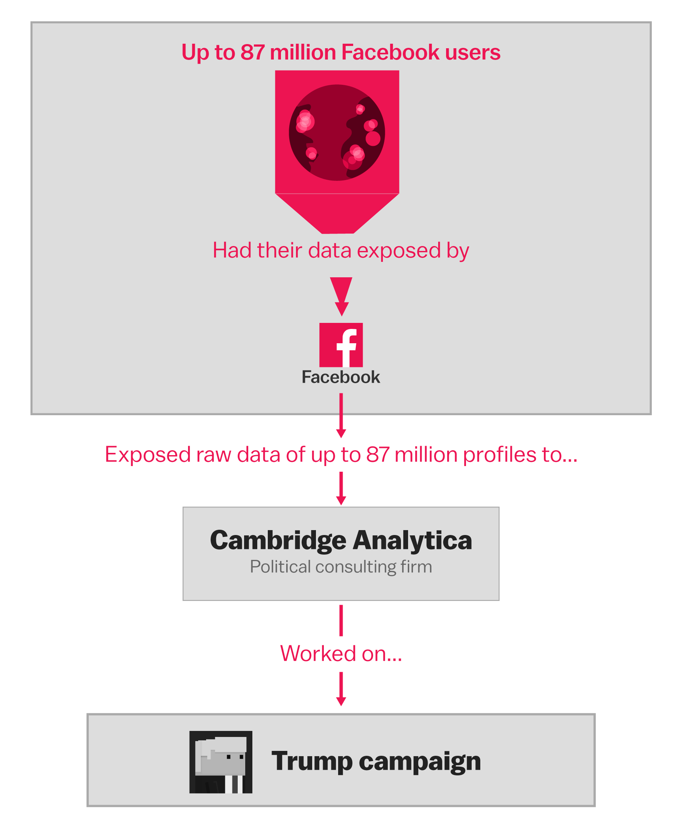
Cambridge Analytica
What happened?
Cambridge Analytica harvested millions of Facebook users' data without consent for political ad targeting.
How?
Data was collected through a Facebook quiz, exploiting user permissions.
Impact?
Led to global investigations, Facebook lawsuits, and ethical concerns over data privacy and election manipulation.

Slide 43

Discussion Questions
If an algorithm can predict and influence voter behavior, should it be allowed? Where do we draw the line between persuasion and manipulation?
Is it ethical for companies to collect and use personal data for political purposes without consent? Why or why not?
Do you think there are any long-term dangers of allowing companies to collect and use personal data unchecked?

